Slide 1
The sightseeing tour of Niš
Hello! Today i will show you our amazing sightseeing tour of a famous city Niš

Slide 2
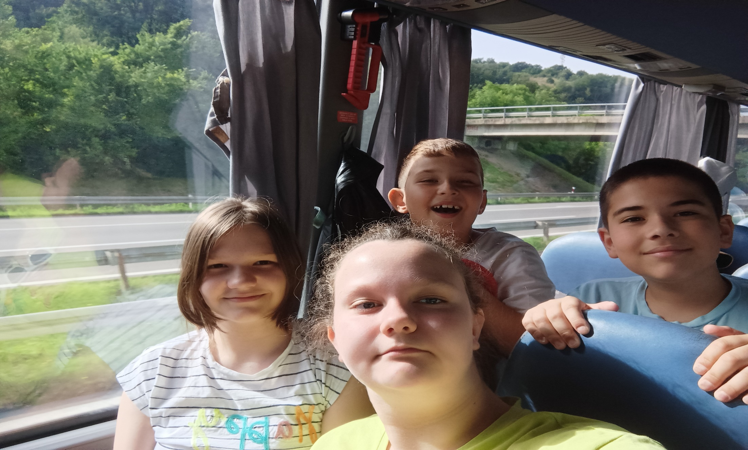
The long drive to Niš
Firstly at the start of our sightseeing tour I was sitting with Filip,while in front of us were Una and Aleksija.We were laughing every second, because I was sort of a clown to them.

Slide 3
Hungry students ‘rob’ the gas station
After a few minutes we arrived at the gas station,and while some had breakfast some bought the whole gas station! They mostly bought a famous chips called takis and a drink made by a famous youtuber called Dex Rock.

Slide 4
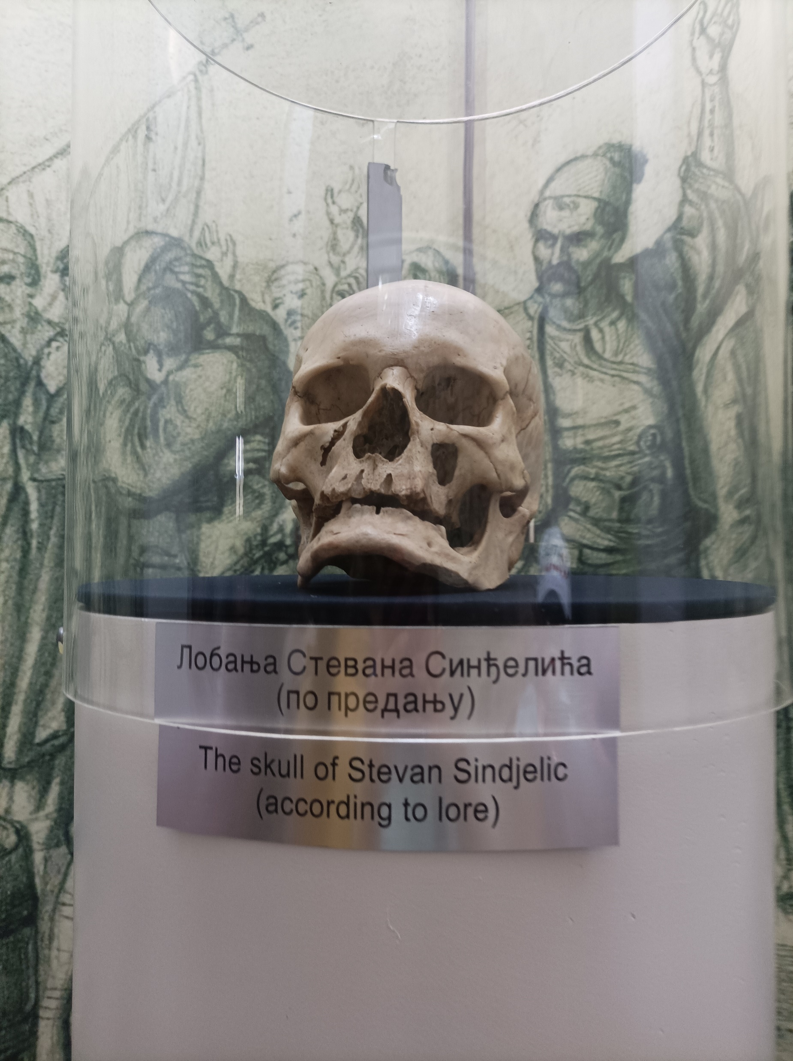
THE Skull Tower
After some time we arrived at our first destination which is in fact the reason many people visit Niš. The skull tower was not very scary to me at first, but when I realised that these skulls stood in the same place for over a decade it gave me chills. The most guarded skull there was the skull of the famous Stevan Sinđelić.

Slide 5
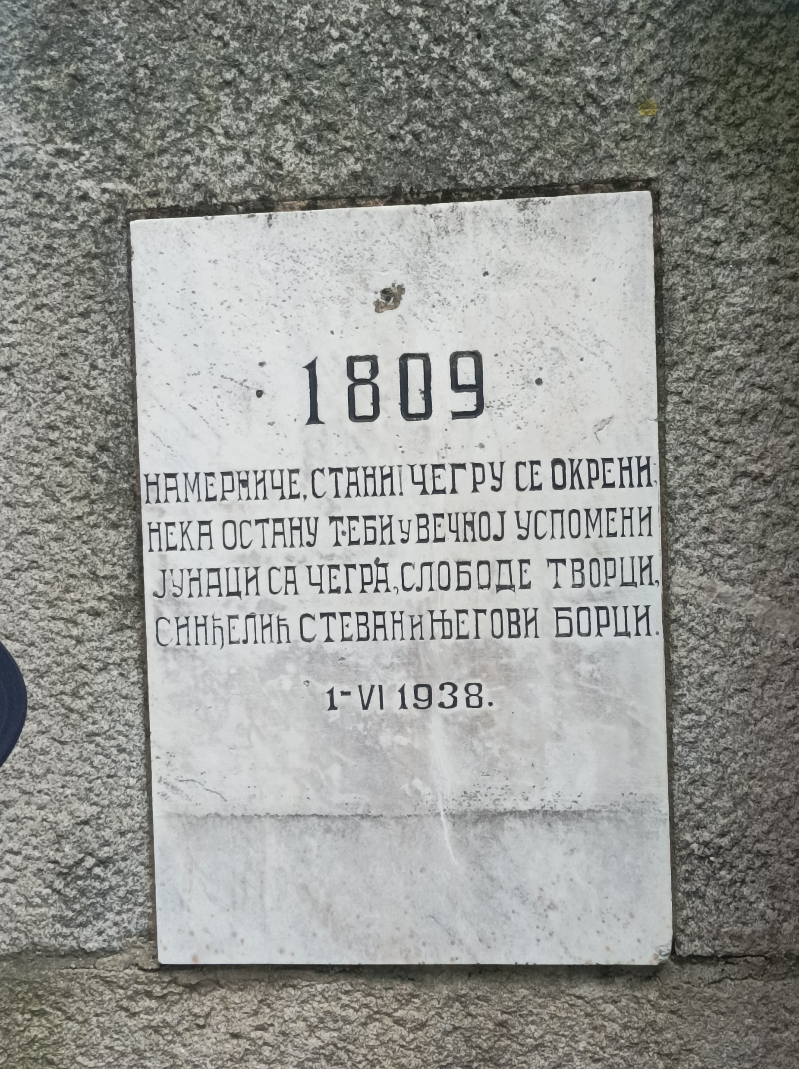
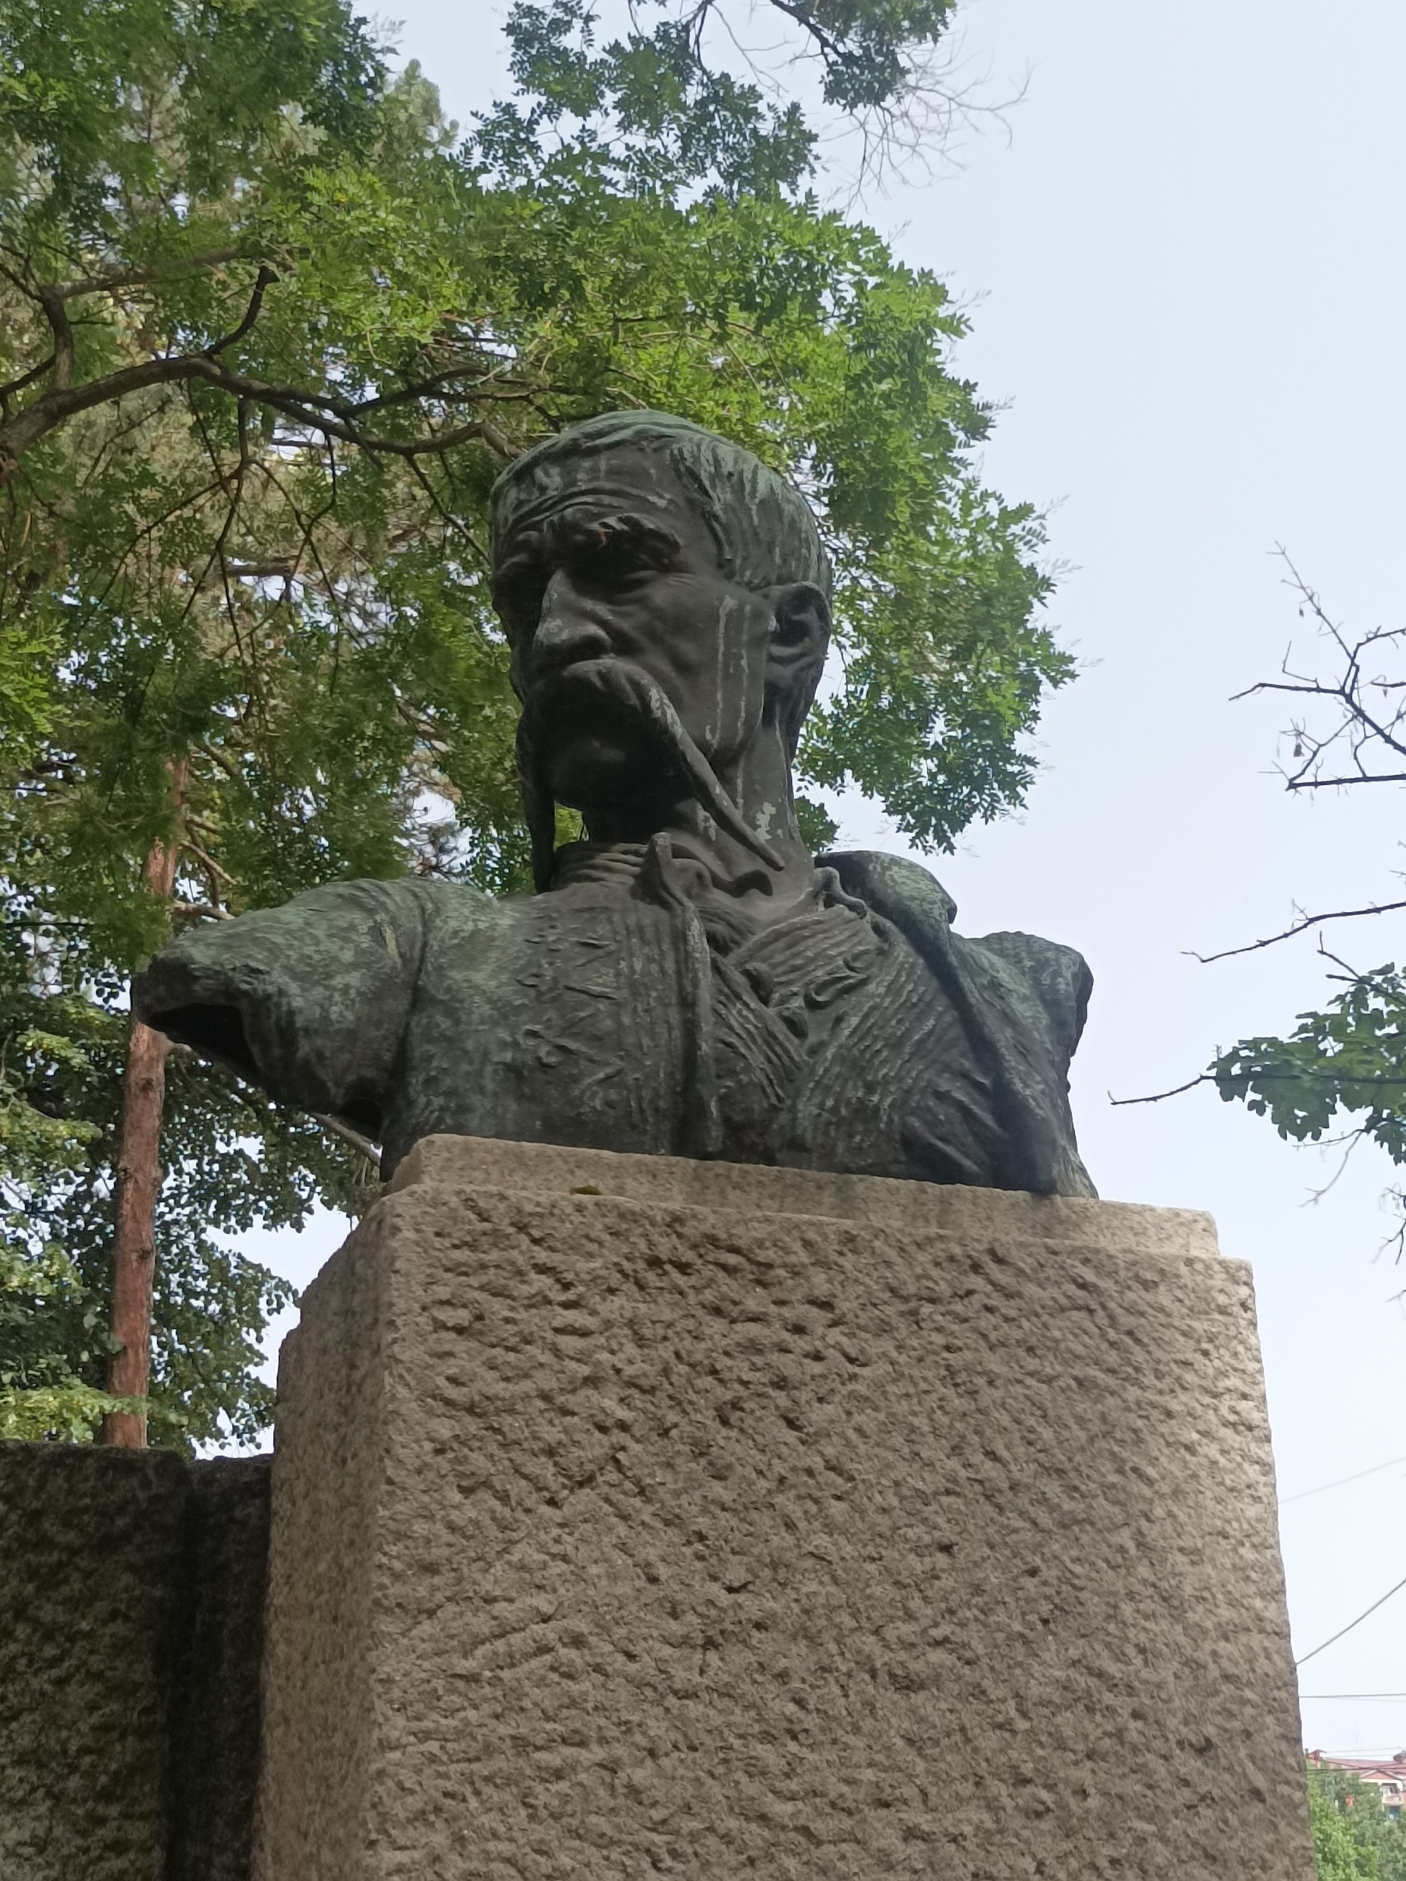

Slide 6
The Forum Mall
Our guide said that we will go to a mall called Forum. All of us were happy and our teacher said that she will wait for us on the first floor. Vojin and I visited the shops to find a vest I have been looking for but we couldnt find it. We spent half an hour looking for what we could buy and the last 5 minutes were very lucky for me - I found a game I could buy for my playstation and my friend Una warned me when the time passed so in the end I bought the game called God Of War.

Slide 7
The amazing puppet show
We watched an amazing puppet show based on the idea never to be greedy. Sadly, every time something happend in the show, a kid said “yuppie”. I personally couldn’t be mad at the kid cause he or she might have been a baby. Anyway we laughted and had a good time!

Slide 8
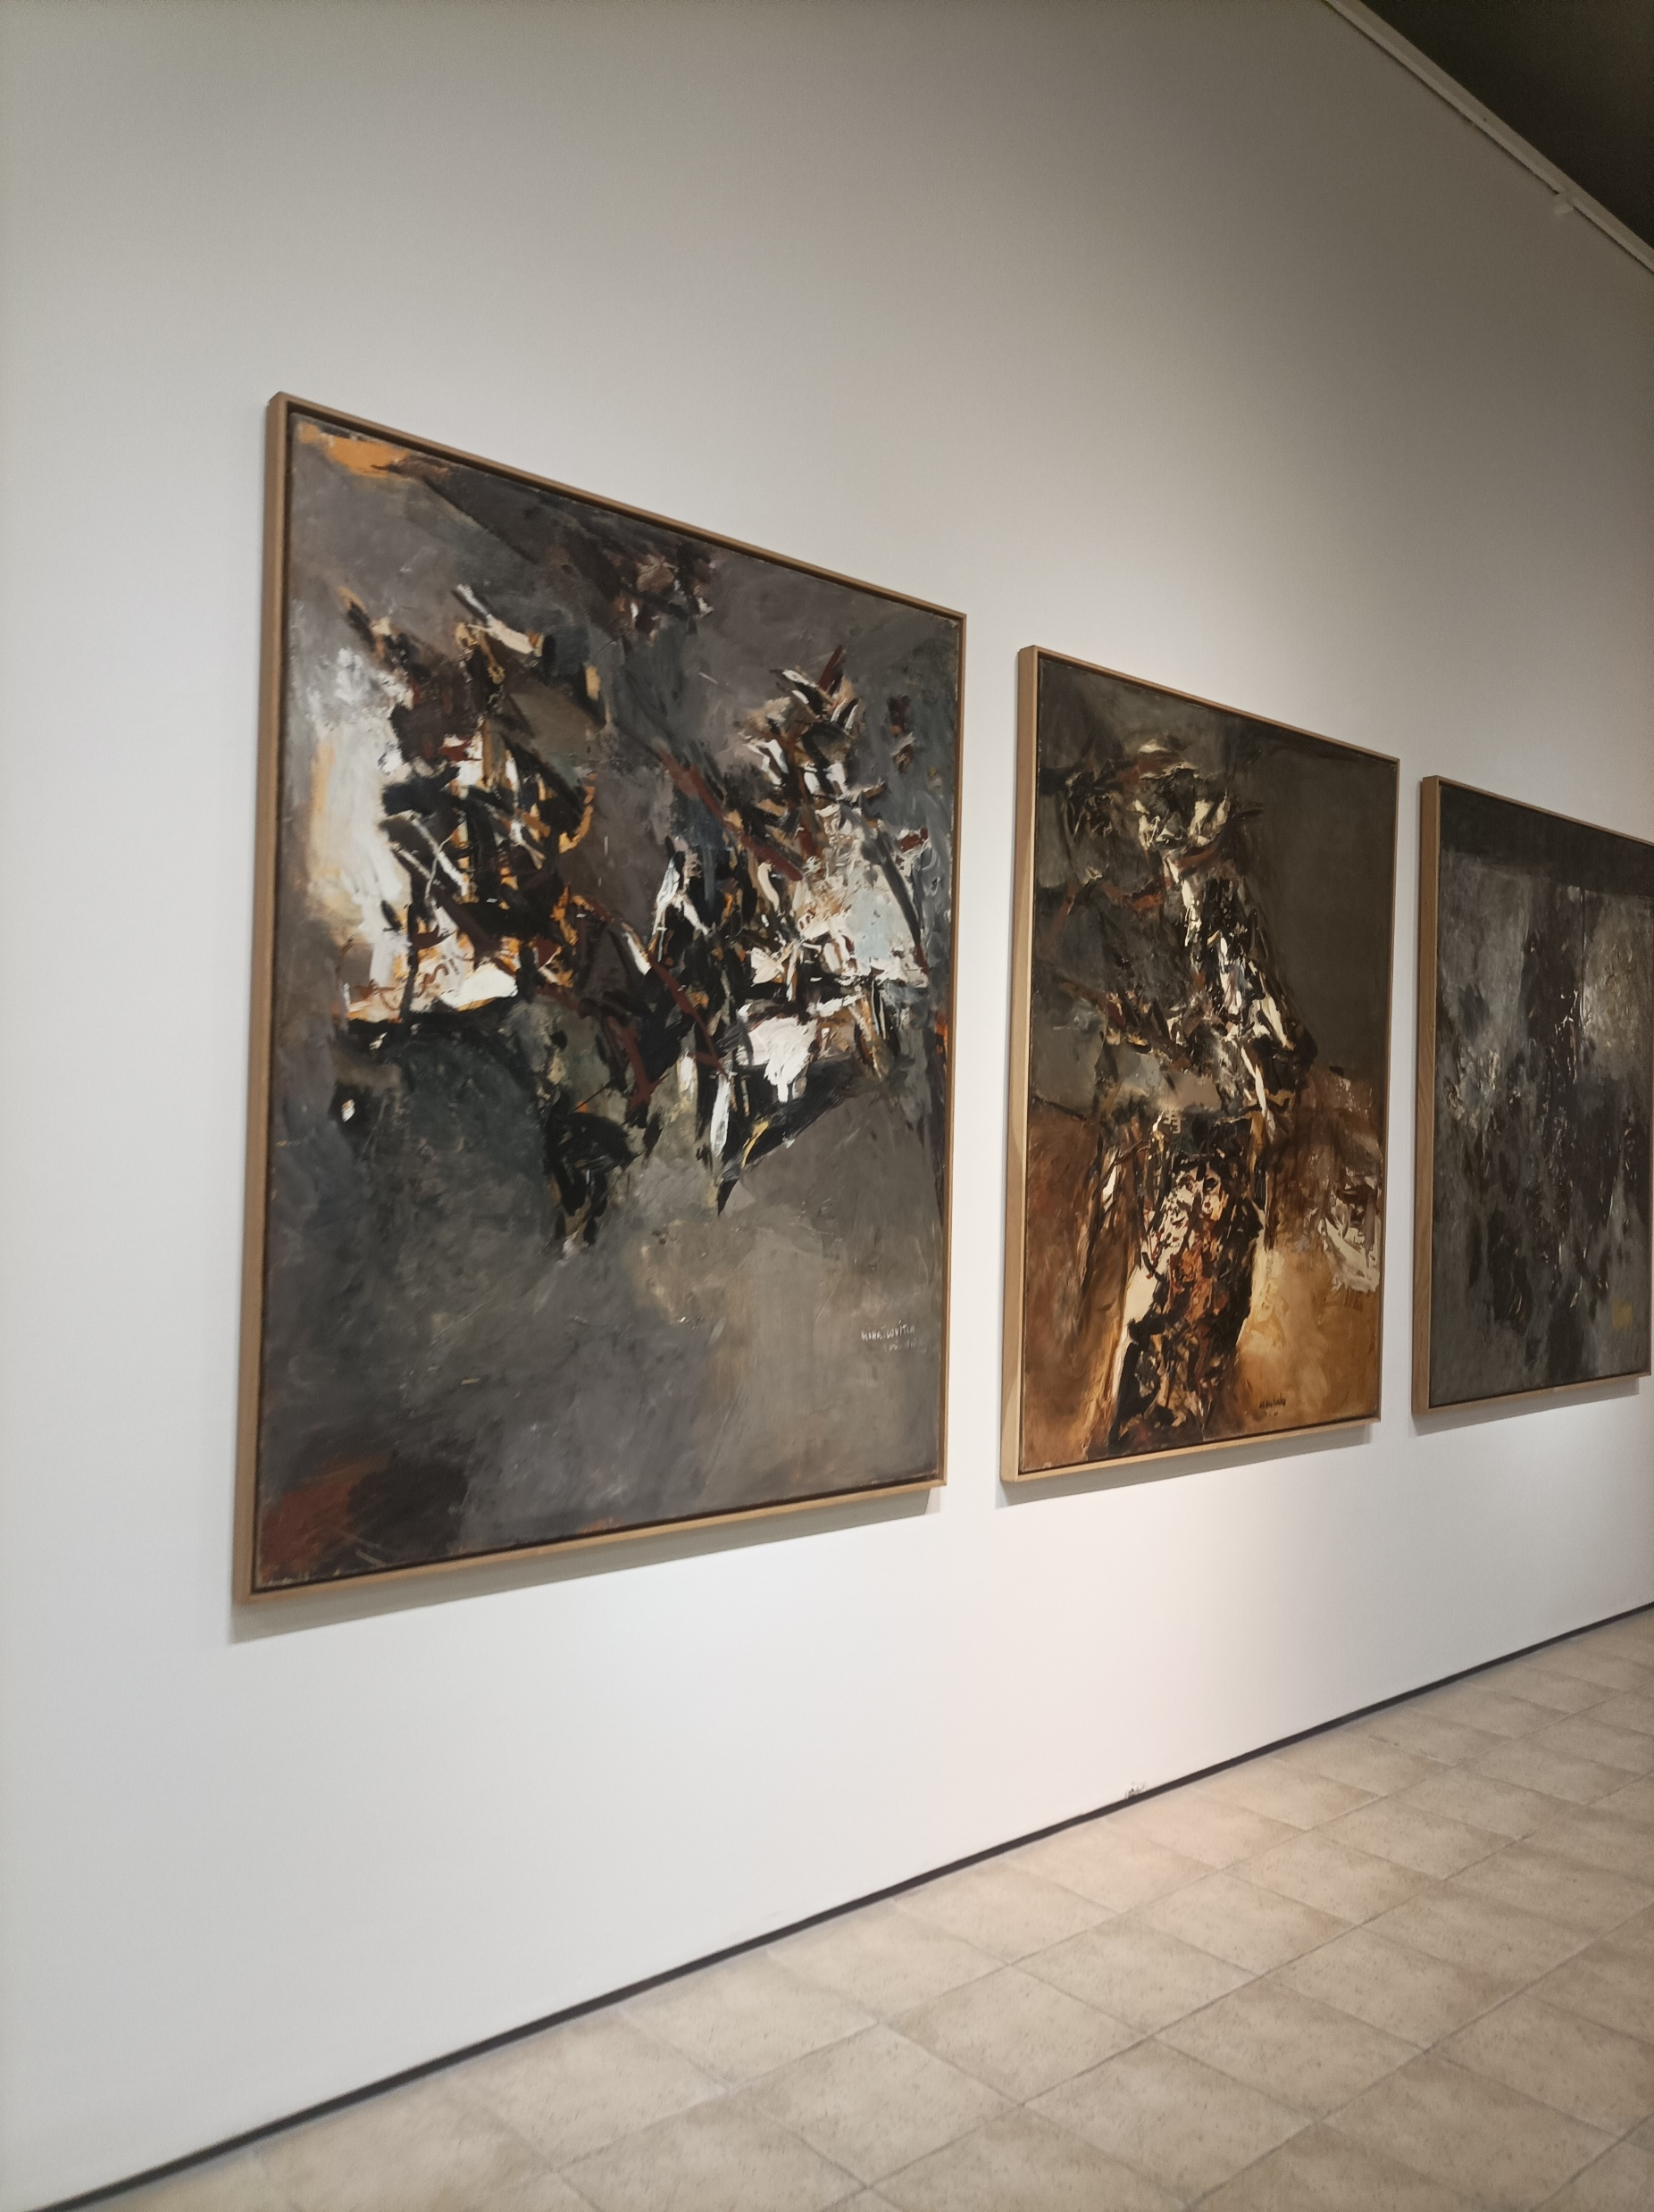
I forgot to mention that a gallery near the forum mall was beatiful and some arts looked like they were made by Leonardo Da Vinci

Slide 9
The todor restaurant
After the puppet show we went to a restaurant.The food was good and in the end I and my 3 friends Ognjen, Aca and Dušan laughed at the joke Ognjen made.

Slide 10
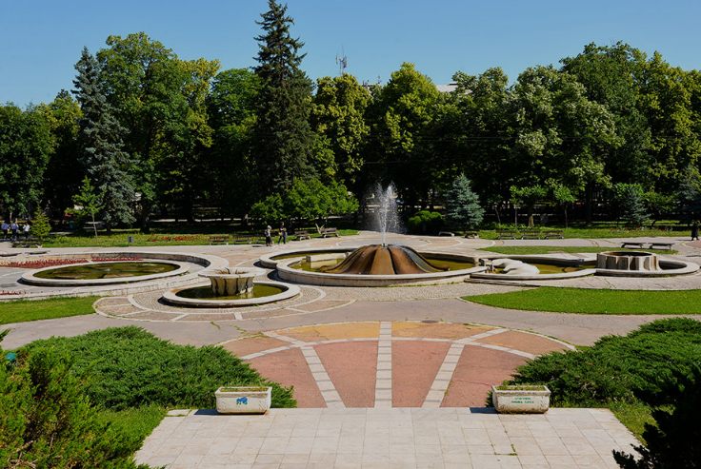
Niška Banja
After lunch, we all rested for a some time.We bought ice creams and magnets, some even bought toys. The most of time I spent with Una ,Vojin and Dušan who joined later, then I joined one group to play football and even managed to score a goal!

Slide 11
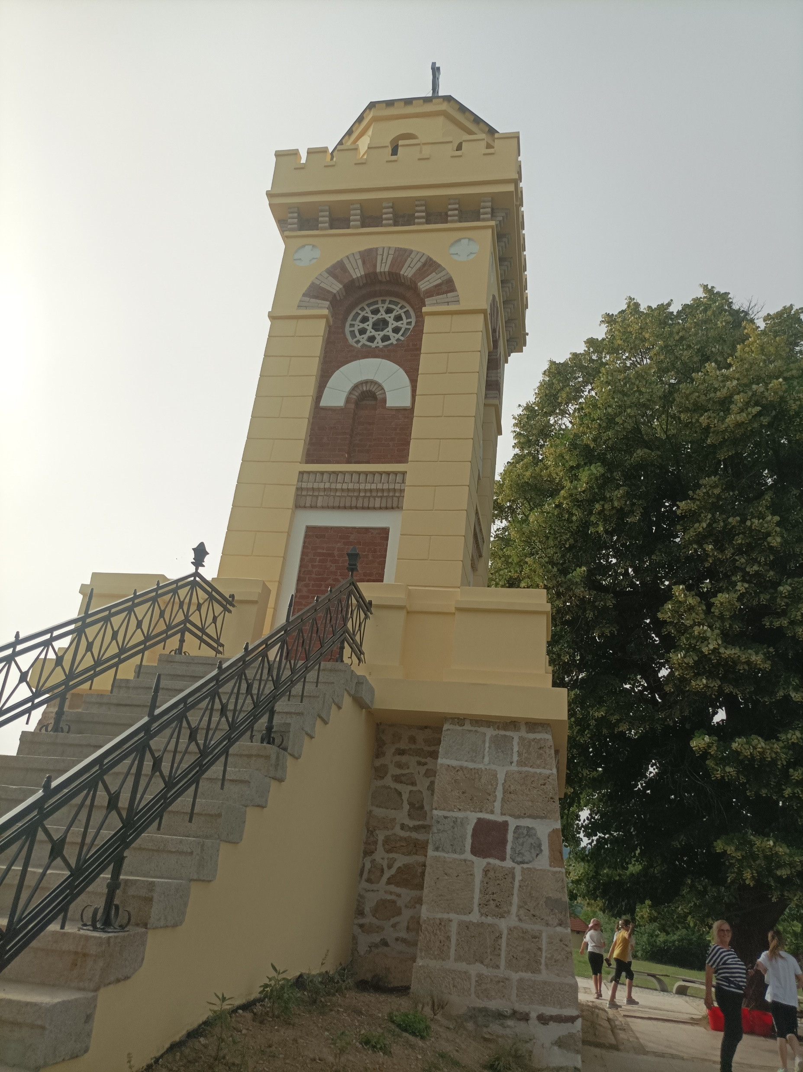
čegar HILL
Honestly the whole hill suprised even though we didn’t really explore it; an old grandad that was a good old friend of my friend Aca’s grandad gave him a free book he made. I saw the book and realised that it was the book my brother and sister bought when they were here.

Slide 12
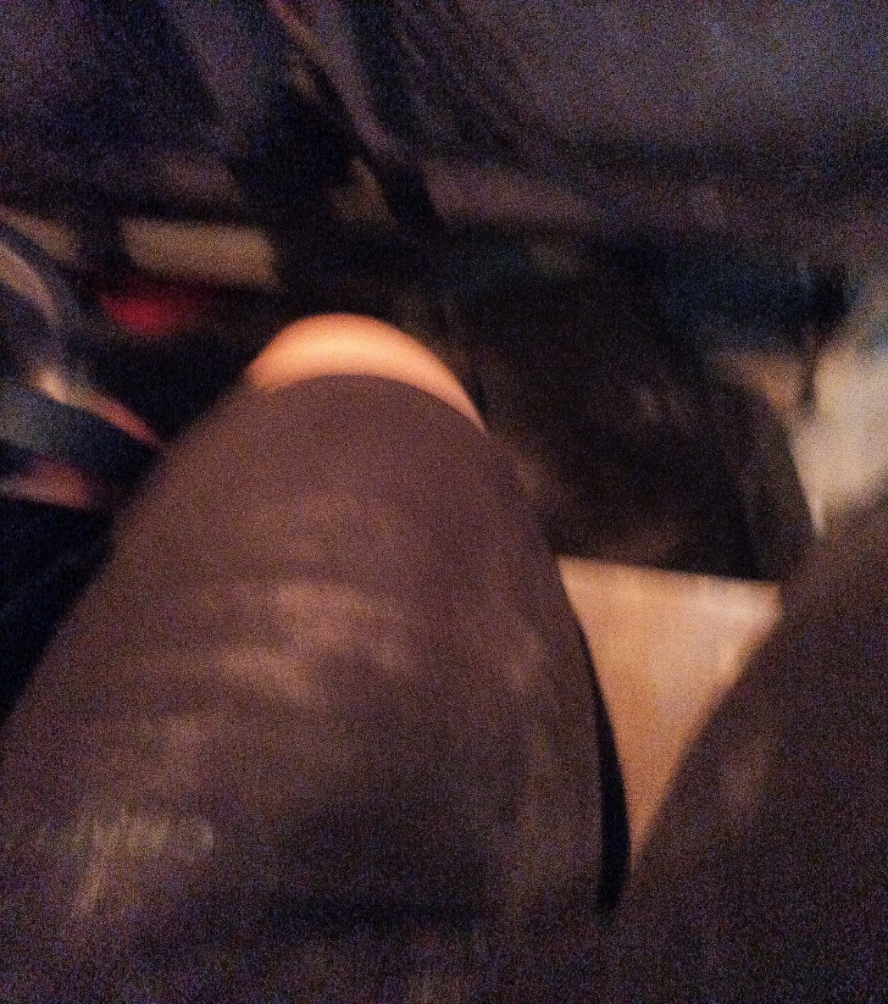
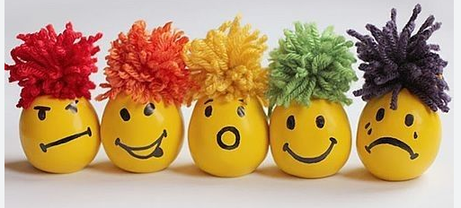
And here we is the part that will most likely make you laugh. Emily bought a toy that she gave to a friend from the other class called Dušan,then Dušan gave it to Mihajlo from the other class then he gave it to Filip. After a while a quarrel started. Filip was picking me when the incident happend. I slightly squeezed the ballon not knowing that it will explode on me. It was full of flour and we had to pick it up from my shorts and backpack.

Slide 13
The end
Thank you for listening and watching my presentation see you again soon.
Toodles!

